Slide 1
Rapid Threat Model Prototyping (RTMP)
Threat modeling for Agile and DevOps

Slide 2
Key concepts and goal of RTMP
#
Using prototyping concepts and Agile Architecture principles

Slide 3


Rapid system prototyping
CONCEPT
Identify basic requirements
Conceptual design
Test the prototype and provide feedback
Revise, Enhance and Repeat

Slide 4
Goals in Threat Model process
CONCEPT
CONSISTENT data
To enable data collection across projects
REPEATABLE process
To enable a single threat model operation
MEASURABLE results
To enable capability to research trends
Perfect for Agile & DevOps
Threat modeling allows teams which have little experience in “thinking like an attacker “ to pentest the software thinking like an attacker
4

Slide 5




Threat Model prototyping
CONCEPT
Identify BUSINESS requirements to drive threat model design
Conceptual design in the development sprints
Test the prototype
with zones of trust
Revise, Enhance and Repeat
Just enough information… 80/20 rule (Pareto)

Slide 6
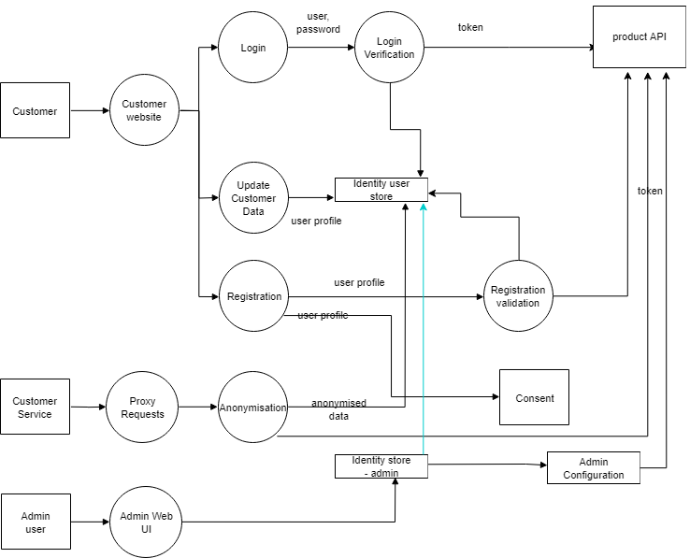
Zones of Trust
CONCEPT
Not in control of system
Boundary
Low
Medium
High
Critical
6

Slide 7
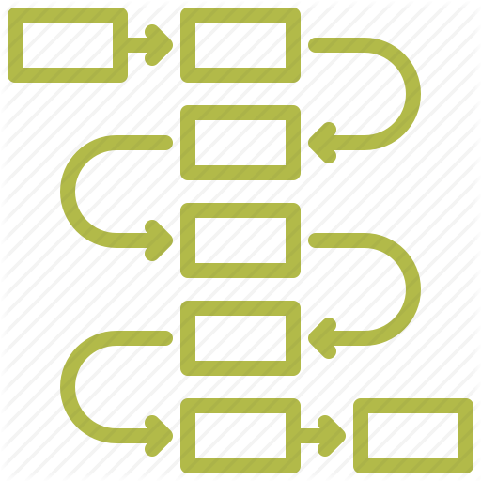

Prioritization methods for triaging
CONCEPT
Counting the number of STRIDE elements to discover higher chance of a weak Node/data store
Counting the STRIDE along a full data flow to prioritize the Nodes and Flows along the full data flow with the highest count
7

Slide 8
The attack-kill-chain and Zones-Of-Trust
#
How elevation-of-privilege threats can be discovered

Slide 9
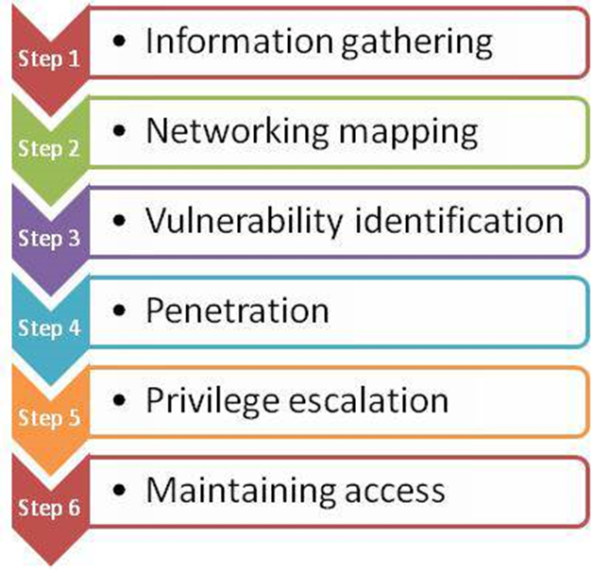
Elevation Of Privilege threats are the most dangerous in the killchain
Step 1 - Gather information on the target
Step 2 - Discover layout inside zone of trust
Step 3 - Find weak point for entry into system
Step 4 - Exploit weak point to gain entry
Step 5 –
Assume a more dangerous permission set via system weakness
Lateral movement in system
Step 6 –
(Passive) collect data in system
(Active) Take control of more of target system

Slide 10
Look for Zone changes to find Elevation Of Privilege
Not in control of system
Boundary
Low
Medium
High
Critical
10

Slide 11
Doing a Threat Model using RTMP
#
What are the steps?

Slide 12
Identify Nodes
Find out their criticality from knowledgeable team members
Add relevant metadata to each node to describe the purpose of the node
e.g. process
Function
Sub-system
microservice
12

Slide 13
Identify Flows
Find out the logical communication connections between nodes
Make the arrows point in the direction of the “request” as opposed to the “response”
The “request” is usually the command and is more useful to attacker (dangerous)
The “response” is usually data but not as dangerous as the “request”
13

Slide 14
Number the Zones of Trust by criticality
Not in control of system
Boundary
Low
Medium
High
Critical
0
1
2
3
4
5
6
7
8
9
14

Slide 15
Zone Rule
0
Not in control of system
Boundary
Low
Medium
High
Critical
0
0
0
15

Slide 16
Boundary Zones
1
Not in control of system
Boundary, external communication
Low
Medium
High
Critical
1
1
1
16

Slide 17
Low Zone
3
Not in control of system
Boundary
Low trust, data passes through
Medium
High
Critical
3
2
3
3
2
17

Slide 18
Medium Zone
5
Not in control of system
Boundary
Low
Medium, business rules processing
High
Critical
5
4
4
5
18

Slide 19
High Zone
7
Not in control of system
Boundary
Low
Medium
High, business critical processing
Critical
6
7
6
19

Slide 20
Critical Zone
Not in control of system
Boundary
Low
Medium
High
Critical, data hits the disk
8
9
8
9
20

Slide 21



RTMP Zone Rules using STRIDE
Find source of data entering the system This is usually Zone 0
Find where data sinks out (hits the disk or exits)
This is usually Zone 6-9
Calculate the positive or negative difference between nodes
calculate based on direction of flow
Apply the elements of STRIDE based on the calculated difference
there can be multiple STRIDE elements per node

Slide 22
Apply STRIDE by Zone math
0
1
S
Spoofing (target node)
‘Not in control of system’ to any other
Tampering
Less critical to more critical
Repudiation
Spoofing +Tampering, or T+S
Information Disclosure
More critical to less critical
Denial of Service
‘Not in control of system’ to any other
Elevation Of Privilege
Less critical to more critical
0
1
S
0
1
S
22

Slide 23
Apply STRIDE by Zone math
T
0
1
T
5
T
7
3
T
T
T
8
Spoofing
‘Not in control of system’ to any other
Tampering (on flow)
Less critical to more critical
Repudiation
Spoofing +Tampering, or T+S
Information Disclosure
More critical to less critical
Denial of Service
‘Not in control of system’ to any other
Elevation Of Privilege
Less critical to more critical
5
T
T
T
3
4
T
T
0
3
2
1
T
T
T
T
9
0
1
6
T
T
23

Slide 24
Apply STRIDE by Zone math
0
1
3
R
R
Spoofing
‘Not in control of system’ to any other
Tampering
Less critical to more critical
Repudiation (target node)
Spoofing +Tampering, or T+S
Information Disclosure
More critical to less critical
Denial of Service
‘Not in control of system’ to any other
Elevation Of Privilege
Less critical to more critical
5
R
3
R
0
1
3
R
R
9
0
1
R
R
24

Slide 25
Apply STRIDE by Zone math
Spoofing
‘Not in control of system’ to any other
Tampering
Less critical to more critical
Repudiation
Spoofing +Tampering, or T+S
Information Disclosure (on flow)
More critical to less critical
Denial of Service
‘Not in control of system’ to any other
Elevation Of Privilege
Less critical to more critical
8
3
I
2
I
9
I
6
25

Slide 26
Apply STRIDE by Zone math
0
1
D
D
Spoofing
‘Not in control of system’ to any other
Tampering
Less critical to more critical
Repudiation
Spoofing +Tampering, or T+S
Information Disclosure
More critical to less critical
Denial of Service (target node and flow)
‘Not in control of system’ to any other
Elevation Of Privilege
Less critical to more critical
0
1
D
D
0
1
D
D
26

Slide 27
Apply STRIDE by Zone math
E
0
1
3
5
7
E
E
E
8
Spoofing
‘Not in control of system’ to any other
Tampering
Less critical to more critical
Repudiation
Spoofing +Tampering, or T+S
Information Disclosure
More critical to less critical
Denial of Service
‘Not in control of system’ to any other
Elevation Of Privilege (target node)
Less critical to more critical
5
E
E
3
4
E
E
0
3
2
1
E
9
E
0
1
E
6
E
27

Slide 28
Analyze Threats to get to the Mitigations now
Model
Analyze Threats
Analyze Mitigations
Validate
Threat Model type
28

Slide 29
Mitigation mapping
STRIDE
OWASP Top 10 (OT10) 2021
L6. Elevation of Privilege | A01:2021-Broken Access Control
L4. Information Disclosure | A02:2021-Cryptographic Failures
L5. Denial-Of-Service | A02:2021-Cryptographic Failures
L2. Tampering | A03:2021-Injection
L2. Tampering | A03:2021-Injection
L2. Tampering | A05:2021-Security Misconfiguration
L4. Information Disclosure | A05:2021-Security Misconfiguration
L5. Denial-Of-Service | A05:2021-Security Misconfiguration
L6. Elevation of Privilege | A05:2021-Security Misconfiguration
L5. Denial-Of-Service | A06:2021-Vulnerable and Outdated Components
L6. Elevation of Privilege | A06:2021-Vulnerable and Outdated Components
L1. Spoofing | A07:2021-Identification and Authentication Failures
L2. Tampering | A08:2021-Software and Data Integrity Failures
L3. Repudiation | A09:2021-Security Logging and Monitoring Failures
L6. Elevation of Privilege | A10:2021-Server-Side Request Forgery
Find framework mitigation based on STRIDE element mapped to a framework
For example, find mitigation tactics for A07:2021-Identification and Authentication Failures
29

Slide 30
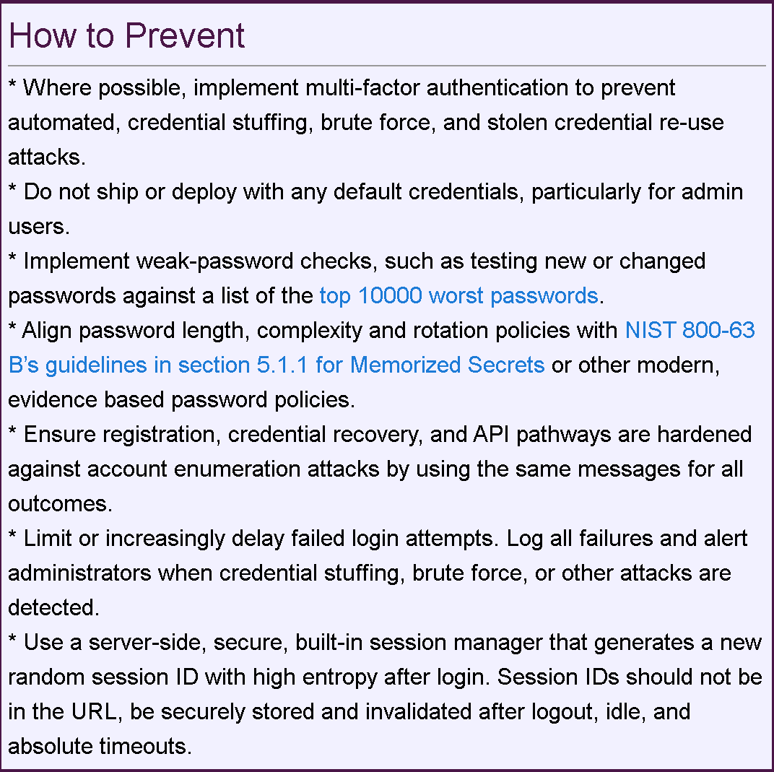
A07:2021-Identification and Authentication Failures Mitigation Tactics
https://owasp.org/Top10/A07_2021-Identification_and_Authentication_Failures
30

